Slide 1
Progress Report (26th Week)
Presented by ltz
24/07/2020

Slide 2
Environment-Independent ASL Gesture Recognition Using 60 GHz Millimeter-wave Signals
Panneer Selvam Santhalingam, Alamin Hosain, Ding Zhang, Parth Pathak, Huzefa Rangwala, Chong Tian, Raja Kushalnagar
Computer Science Department, George Mason University
Department of Science, Technology and Mathematics, Gallaudet University
[The Proceedings of the ACM on Interactive, Mobile, Wearable and Ubiquitous Technologies (IMWUT) 2020]

Slide 3
MOTIVATION
An Home assistant for deaf and Hard-of-Hearing (DHH)
ASL:American Sign Language
Current problems
Voice-controlled interface
RGB, infrared: darkness,privacy
Wearable sensors: High limitations
CSI: SLV, low accuracy
Contributions:
A gesture-based wake-word detection solution
A novel deep learning approach: ASL + deep learning algorithms
Excellent performance (87% average accuracy of sign recognition)
Alexander Toshev and Christian Szegedy, “Deeppose: Human pose estimation via deep neural networks,” in Proceedings of the IEEE conference on computer vision and pattern recognition (CVPR), IEEE, 2014, pp. 1653–1660.

Slide 4
CHALLENGES
Reliable wake-word detection at any location:
Reliable, Low-delay, everywhere
Tolerance to other people's activities
Solution: Spatial spectrograms + CNN
Scalable ASL sign recognition
Home assistant —— can recognize a large number of ASL signs.
Solution: Spectrograms+multi-task deep learning model
mmASL in uncontrolled settings
Significant variations
Presence of other interfering person, change of environment
Solution: Large-scale data collection and analysis

Slide 5
RELATED WORK
mmWave Sensing
2.4/5 GHz CSI/RSSI based systems
Vision, infrared and other modalities
System (Modality) | Device Free / Wearable (DF/W) | Other people impact | Environment impact | User position impact | Lighting impact | Wake word Detection | Non-Intrusive
RGB Camera [1,2,3,4] | DF | Low | Low | Moderate | High | No | No
Depth Camera (Kinect) [5,6,7] | DF | Low | Low | Moderate | Moderate | No | No
DeepASL[8] (Leap motion) | W | None | None | None | None | No | Yes
SignSpeaker [9](IMU) | W | None | None | None | None | No | Yes
SignFI [10] (WiFi CSI) | DF | High | High | High | None | No | Yes
mmASL (mmWave) | DF | Low to Moderate | Low | Moderate | None | Yes | Yes

Slide 6
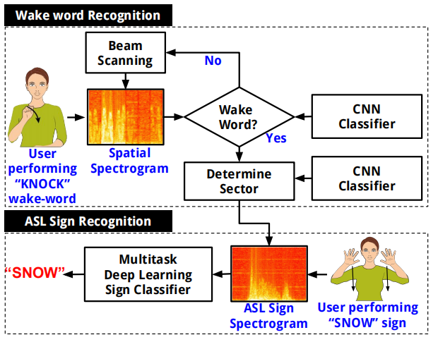
SYSTEM DESIGN
System overview

Slide 7
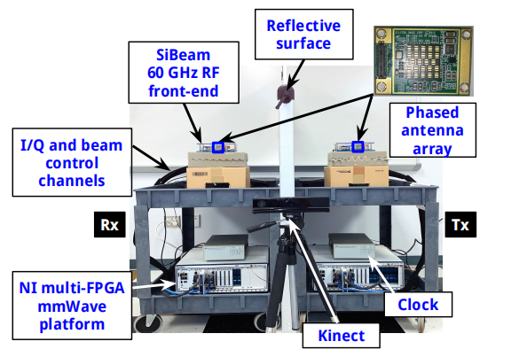
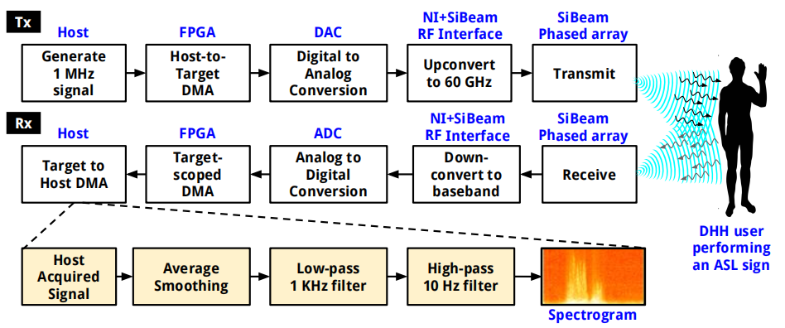
SYSTEM DESIGN
Implementation
Fig. 1. Platform Overview
Fig. 2. Processing pipelines

Slide 8
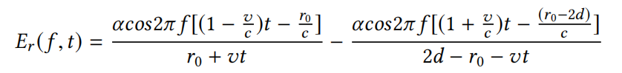
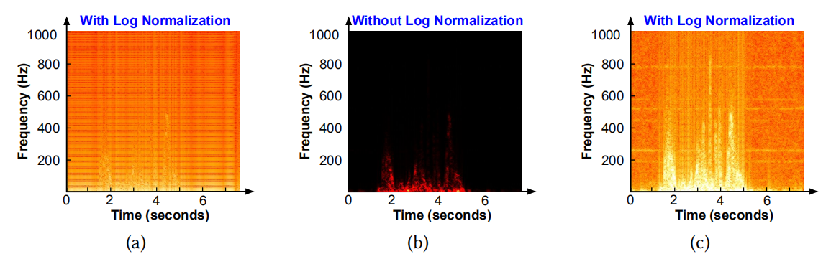
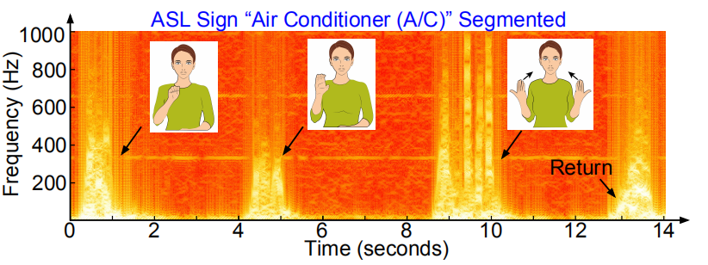
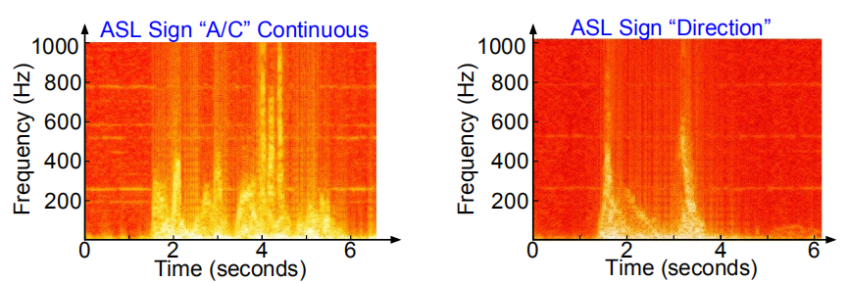
RECONGINZING ASL SIGNS
Feasibility Study

Slide 9
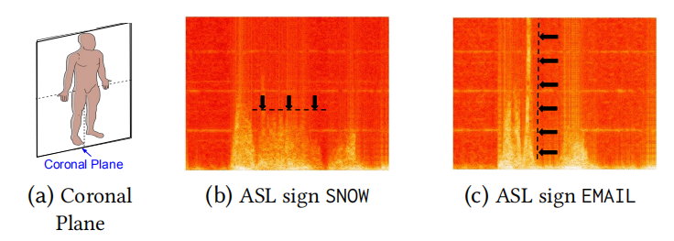
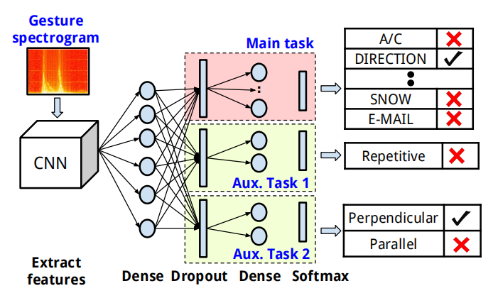
RECONGINZING ASL SIGNS
ASL Phonological Properties in Spectrograms
Repetitive + motion direction
Multitask Learning Model
Main task: ASL sign recognition
Auxiliary tasks:Repetitive, motion direction
enhance

Slide 10
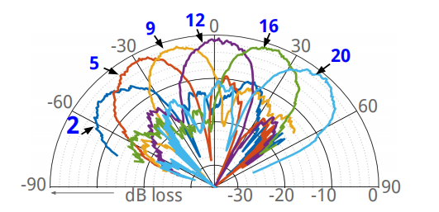
WAKE WORD RECOGNITION
2 challenges:
Timeperformance trade-off
Presence and motion of other people
Selecting Scanning Sectors
the number of sectors to scan
the number of sectors to scan
25 beam sectors (each 5° apart)
The same coverage as the 25 sectors
Minimum overlap
main lobes + sidelobes

Slide 11
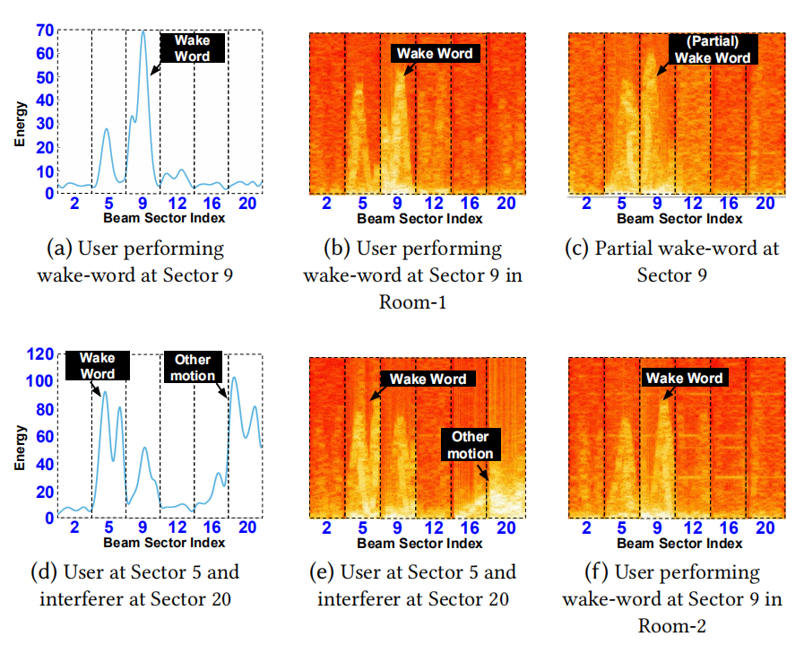
WAKE WORD RECOGNITION
Spatial Spectrograms
X Energy
√ Spatial spectrograms

Slide 12
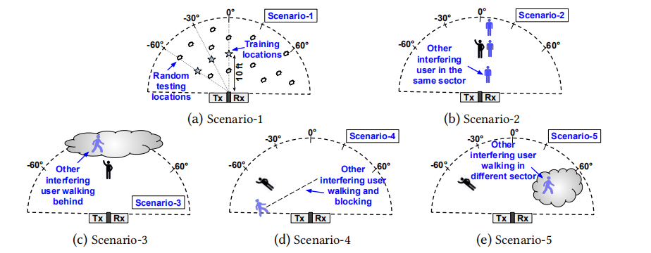
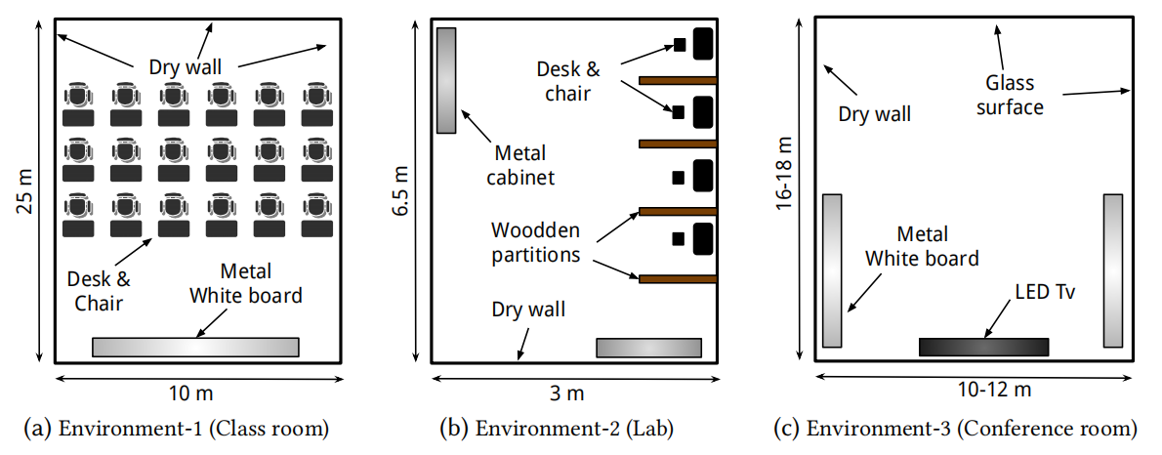
EVALUATION
Scenarios and Environments
Wake-word dataset
3700 samples, 3s/sample, 3 users, 3 different rooms
ASL sign dataset
50 words, 12236 samples, 15 users

Slide 13
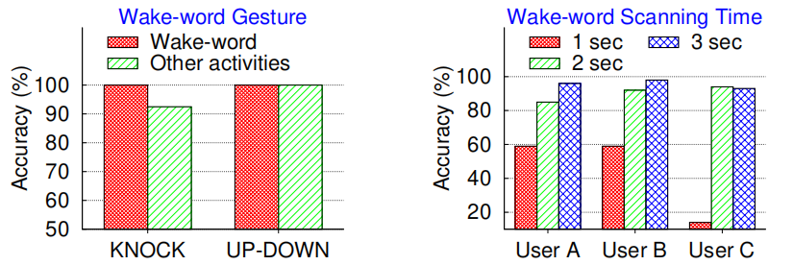
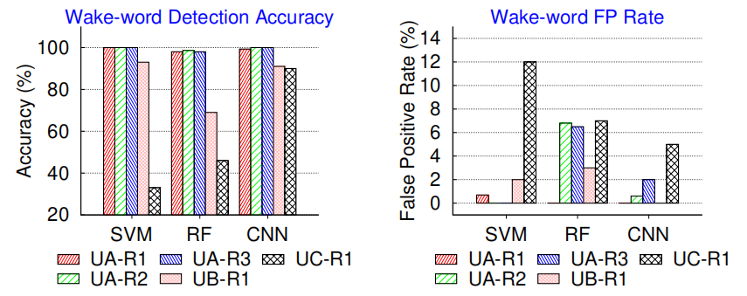
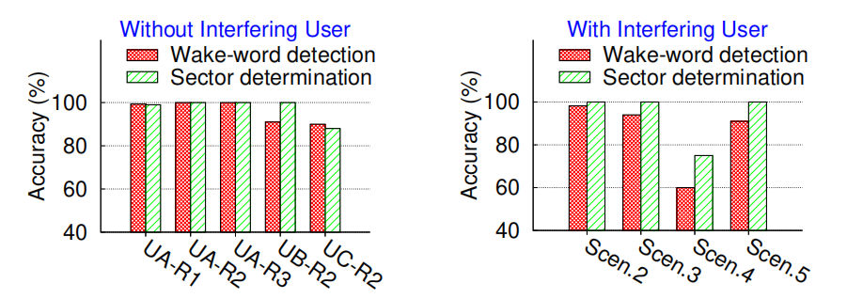
EVALUATION
Wake-word Detection
Wake-word selection Impact of scanning time
Machine Learning model comparison
Scenarios

Slide 14
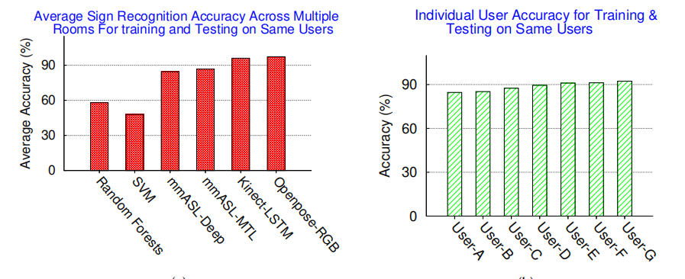
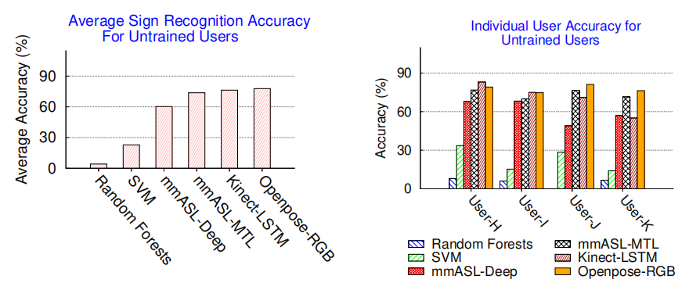
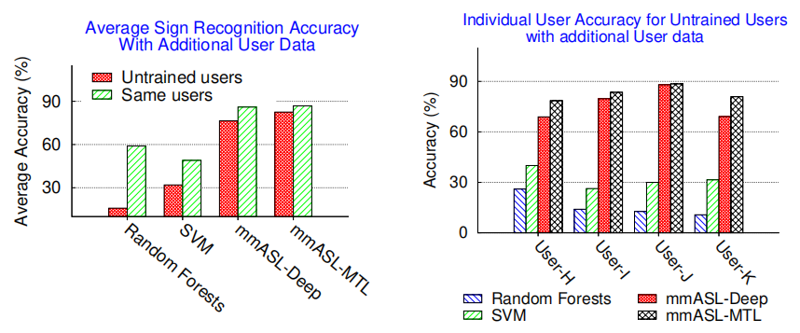
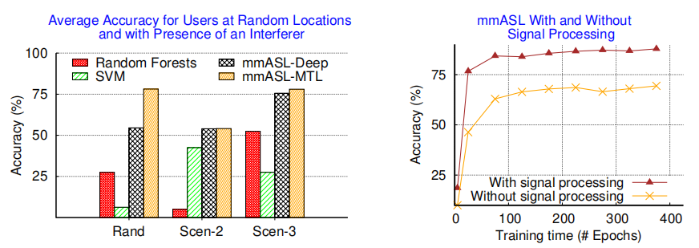
EVALUATION
ASL Sign Recognition
Average sign recognition accuracy Individual user accuracy Average user accuracy

Slide 15
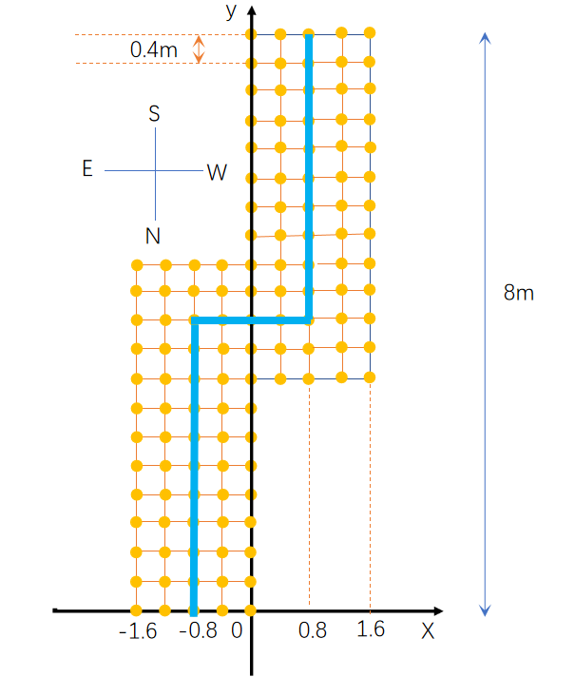
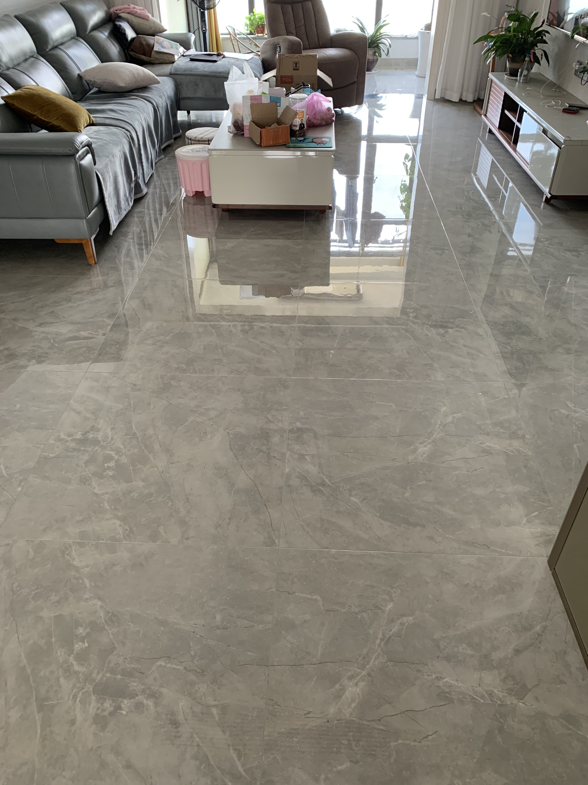
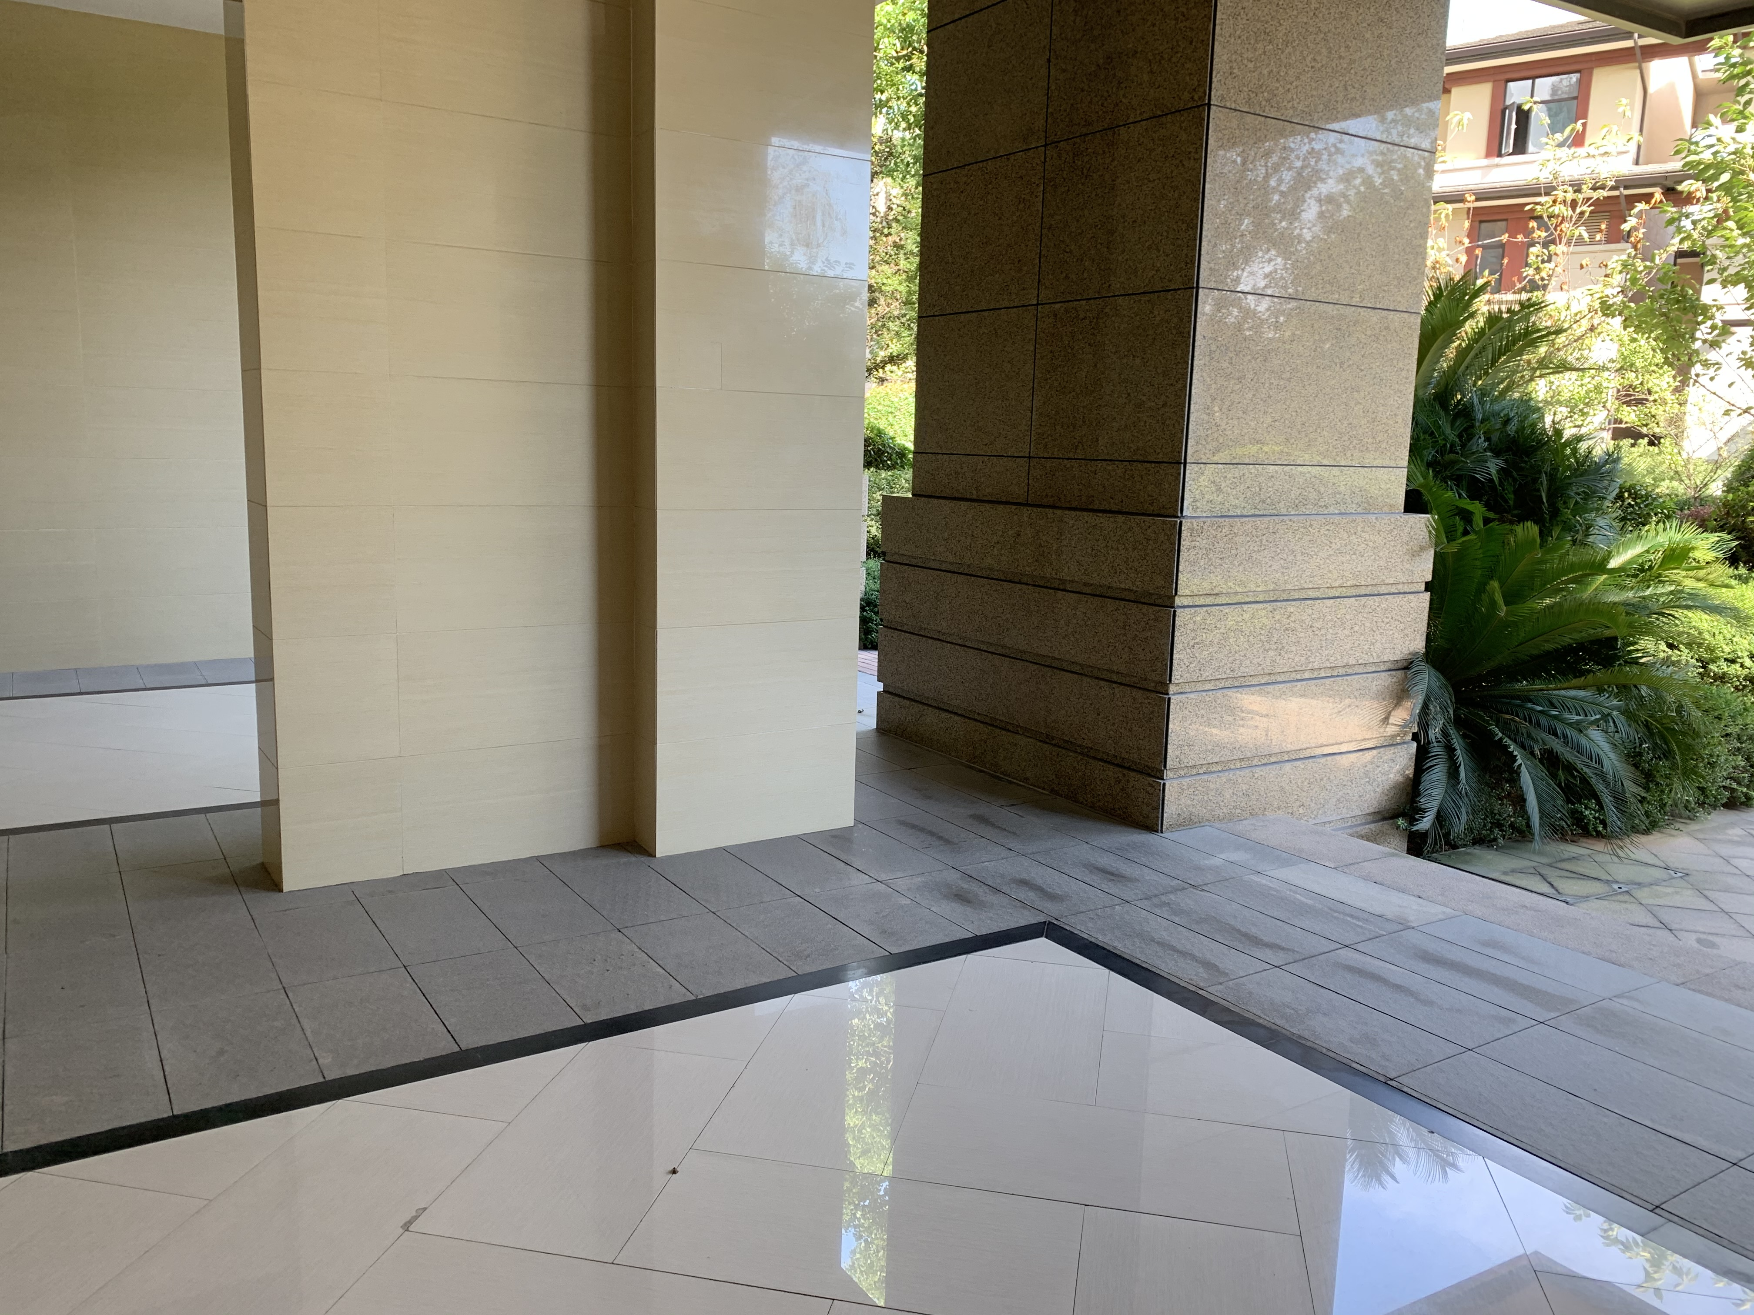
ContextLoc
Indoor
Semi indoor

Slide 16
INSPIRATION
Using mmWaves to achieve an home assistant capable of ASL recognition. The highlight is Wake-word detection.
From where I stand, the most inspiring part of the paper is that machine learning is a very powerful tool. The shortage of mmASL is too heaevy.
Combining with the work of ContextLoc, the evaluation part of the paper inspires me untrained people should be taken into account.

Slide 17
Thanks!

